Slide 1

Data Driven UI
John Rellis
Web Development 1

Slide 2
Today
What is a data model?
Building a UI from data
Introducing components
What is model view controller?
Introducing a datastore
Creating a namespace

Slide 3
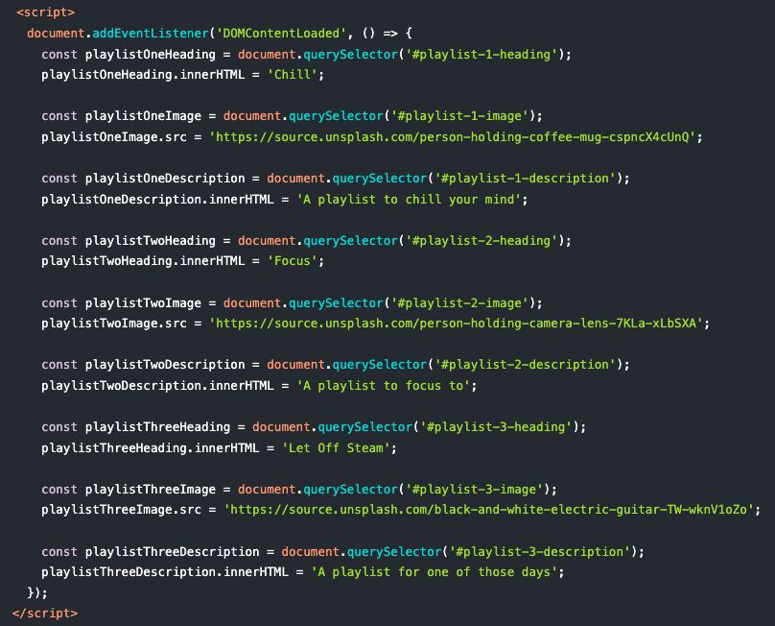
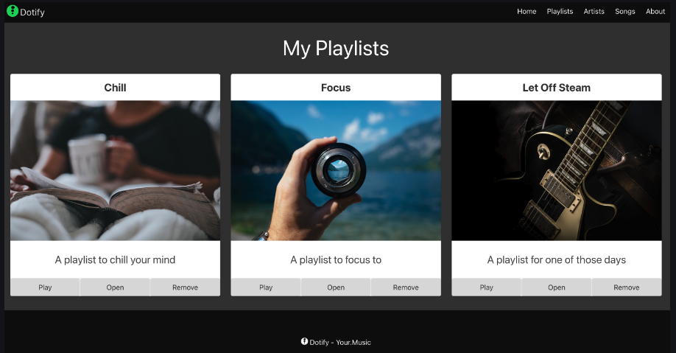
Our present situation
When the page is loaded, hardcoded data is used to populate our user interface
This is useful for learning JavaScript but in the real world it is pointless, we may as well just hardcode the values in the HTML as before

Slide 4
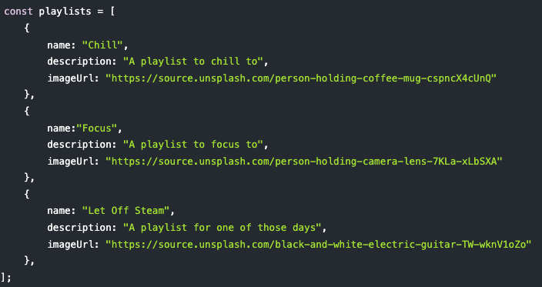
Introduce a data model
Create a data structure that can represent (or model) our domain
Our domain here is music streaming, specifically, playlists.
To model a playlist we can use an object with:
Name
Description
Image Url
We will add all of these to an array

Slide 5
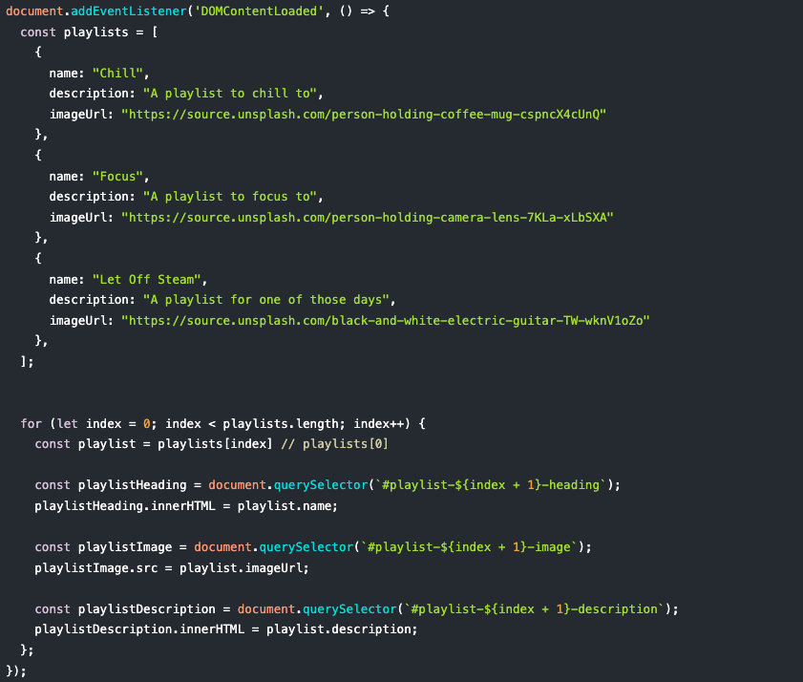
Introduce a data model
We can now use this data model to populate our user interface (or view)
We iterate over the data model to add data to our view
This is the first step in decoupling the user interface from the data itself

Slide 6
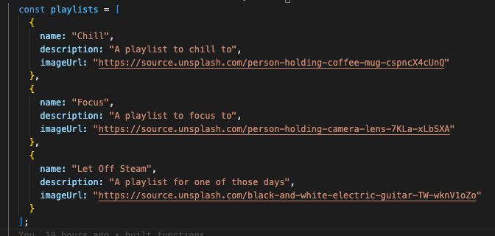
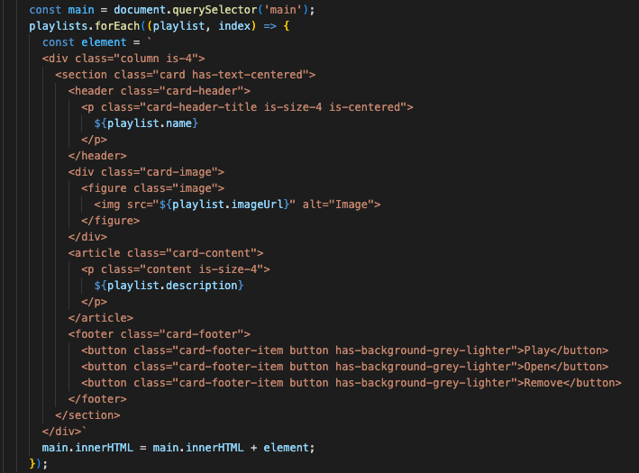
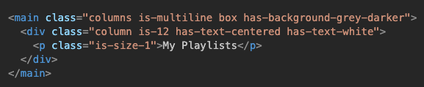
Use data to create the UI
Let’s remove our playlists from our HTML so that we now only have a main element with our heading “My Playlists”
Iterate over our data model and add a card for each entity (or playlist)
We create a string using a template literal and add to the html of the main element

Slide 7
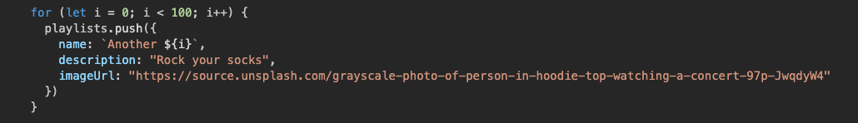
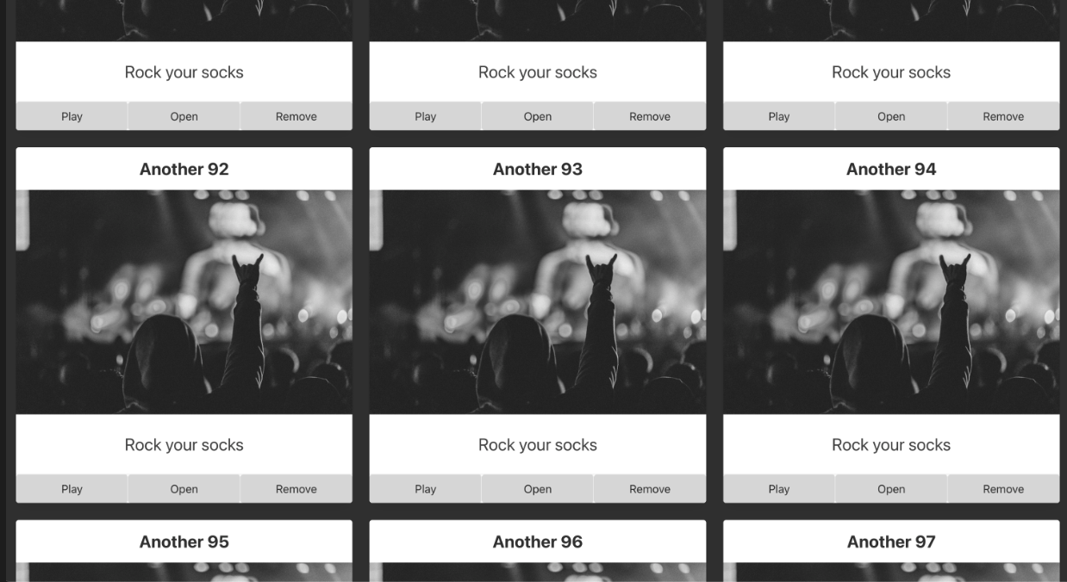
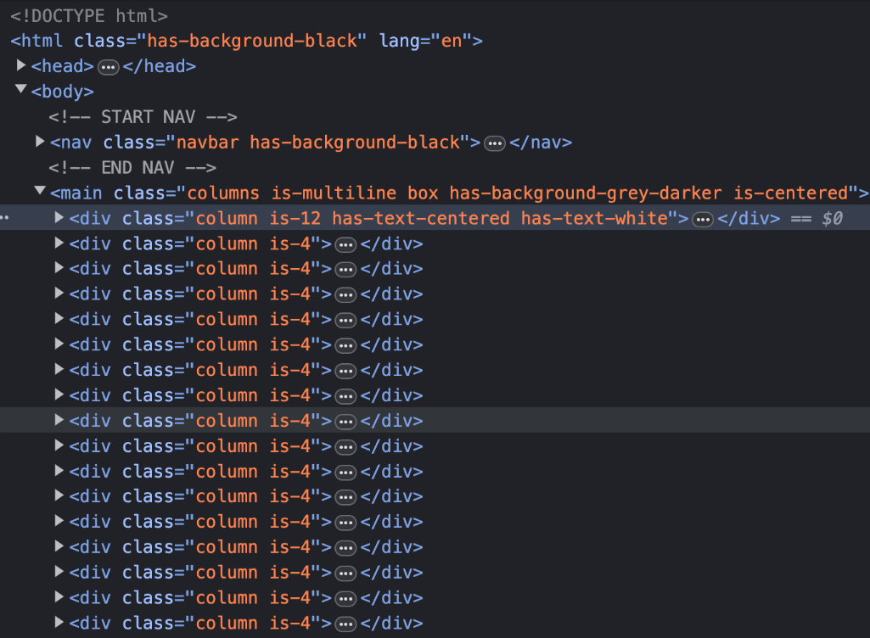
Use data to create the UI
Now we have used data to drive the creation of playlist cards on our page

Slide 8
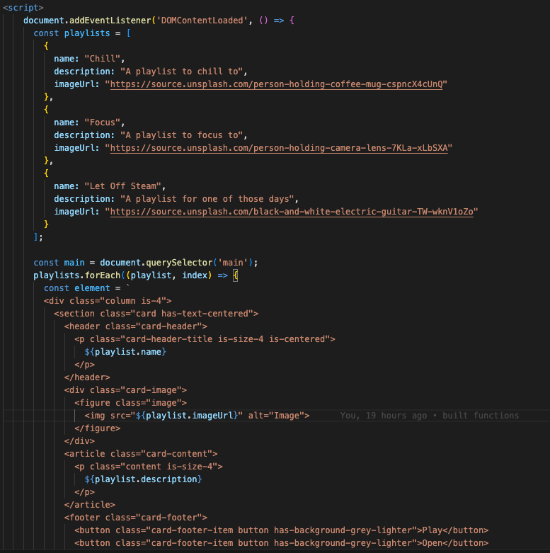
The JavaScript on our page is still quite complicated and difficult to maintain
Let’s refactor the HTML creation into a component

Slide 9

What is a component?
A UI (User Interface) component is a reusable element of a graphical user interface (GUI) that serves a specific purpose in presenting information or enabling user interaction within a software application.
UI components are building blocks used to create the visual layout and functionality of user interfaces.
Think buttons, checkboxes, bulma cards
We will use the term component to refer to reusable pieces of user interface and to extract their creation to a separate file

Slide 10
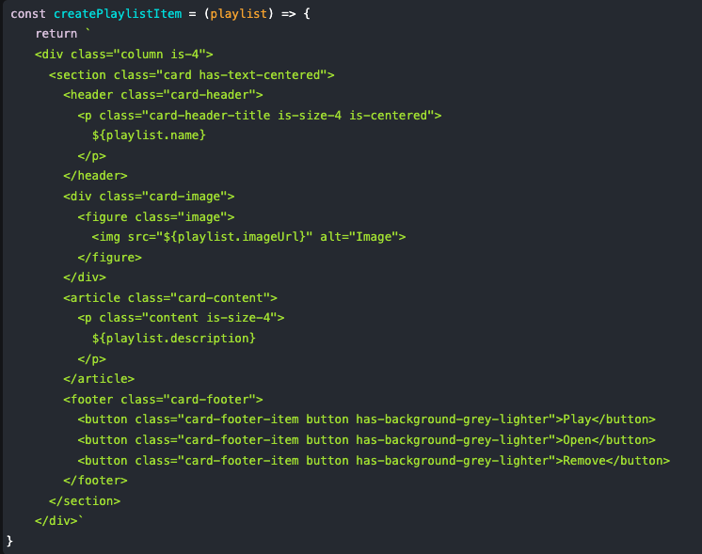
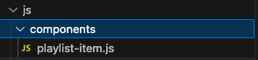
playlist-item.js component
Create a new file
js/components/playlist-item.js
Add a function called createPlaylistItem
Returns a string that has playlist item information populated

Slide 11
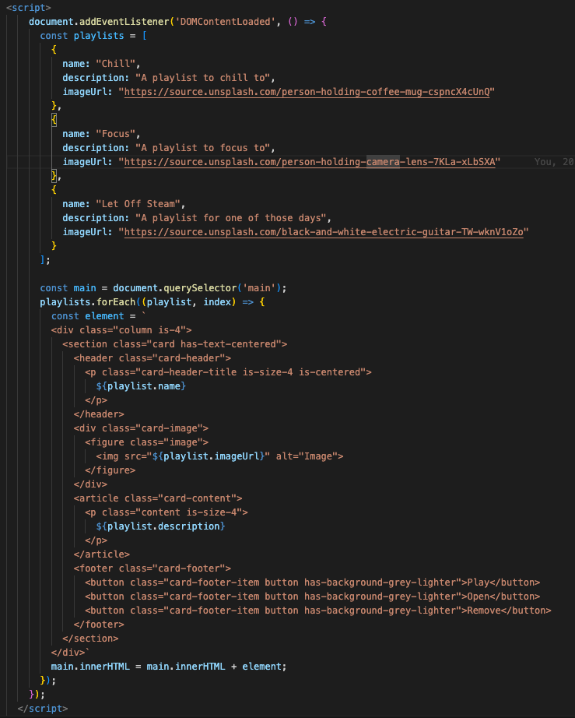
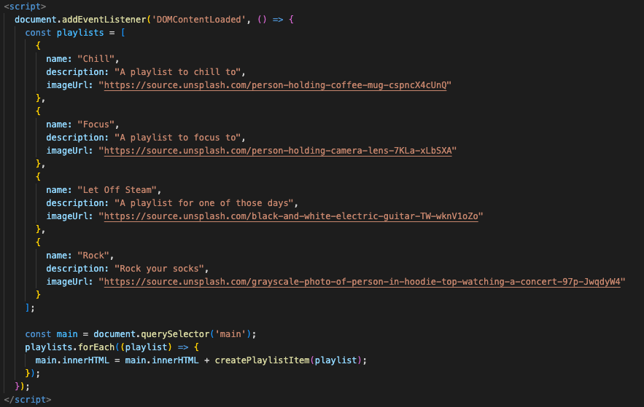
Before vs After

Slide 12

Lots of new words…

Slide 13

model
A representation of a real-world domain in data, in our domain of music streaming a model is made up of
Entities ➔ playlists, songs, artists, albums
Attributes ➔ the properties that make up our entities, e.g. album name, album art
Relationships ➔ How are entities related? A playlist has many songs, an artist has many albums
A domain refers to a specific subject area, problem space, or application area that a software system or model is designed to address such as music streaming, banking, e-commerce, education, movie industry, home espresso making

Slide 14
view
A view is our user interface, in this case, our HTML, CSS and JavaScript
It is what the user sees and interacts with
A view is used to allow viewing of the data model as well as interacting with the data model

Slide 15
component
A reusable piece of user interface

Slide 16
Model – View –Controller (kind of)
I will prepare the data
Can I have data?
Controller
Give me this data
Model
View
Can you update this data?
Update this data
Model View Controller, or MVC, is typically an event driven pattern for creating a data driven user interface
We will use a simplified version to help us compartmentalise our data from our view without the events
Our view will request data from the controller
The controller will format the user request so that it is suitable for model, it may perform multiple queries for one user request
The controller will format the data so that it makes sense to the view from the perspective of it’s request
This is a layered approach to application design to help us enforce Separation of Concerns
The view is concerned with displaying the data
The controller is concerned with formatting and preparing user requests and data
The model is concerned with storing and allowing access to data

Slide 17

Eh?
That’s a lot, we will return to Model-View-Controller next week, I just wanted to plant the seed

Slide 18
Model – View –Controller (kind of)
I will prepare the data
Can I have data?
Controller
Give me this data
Model
View
Can you update this data?
Update this data
For now, we will ignore the controller and allow the view to interact directly with the model

Slide 19
Introduce a data store
We have our view and our model
BUT our model is within our view
To move our model from our view, we will introduce a data store

Slide 20
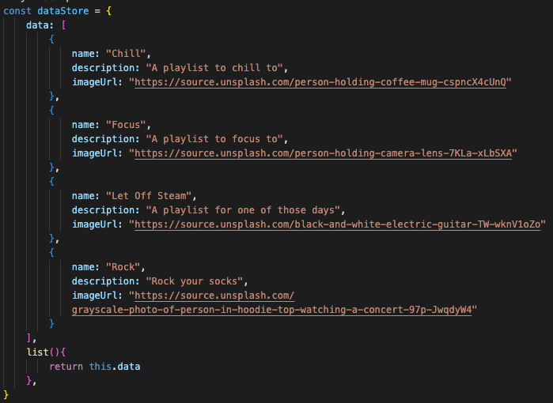
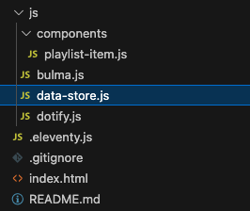

Slide 21
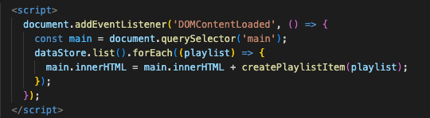

Slide 22

Last piece

Slide 23
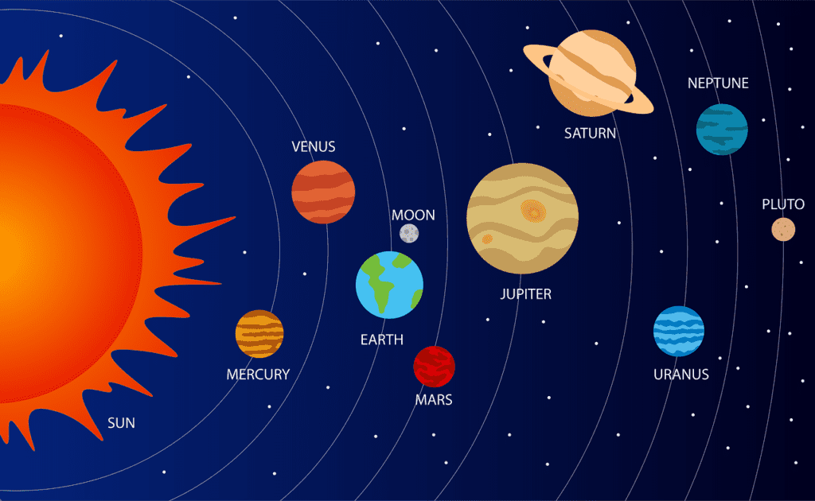
Name Spacing

Slide 24
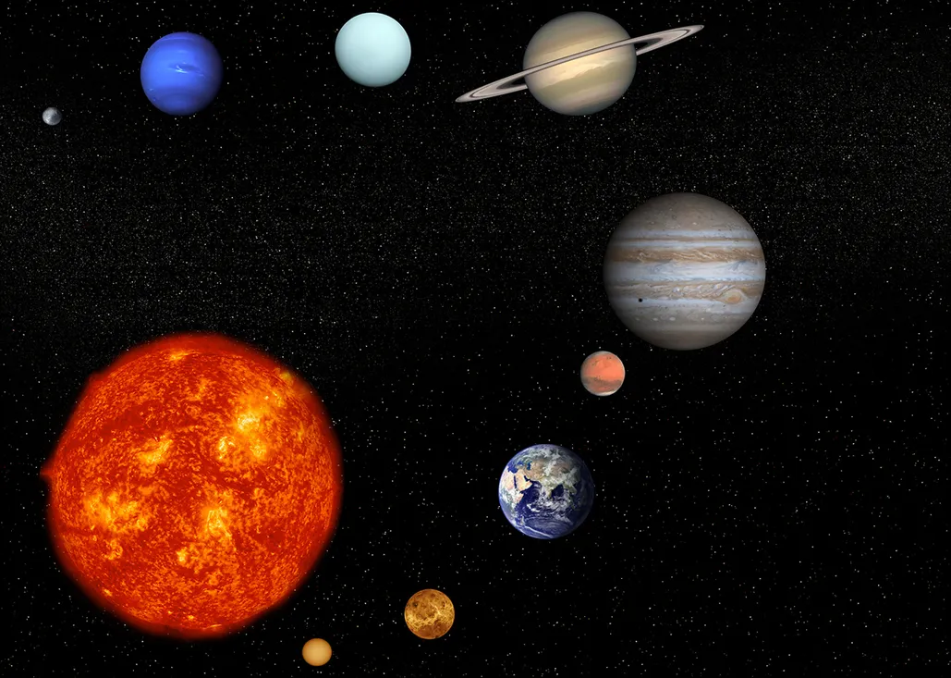
Name Space
So far we have created:
dataStore
createPlaylistItem
These reside in the global scope
If another application adds or manipulates a dataStore or a createPlaylistItem function, it could cause issues on the page.
To help prevent this, we introduce our own namespace

Slide 25
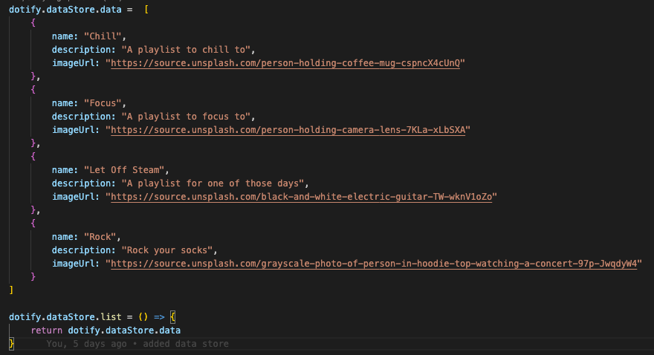
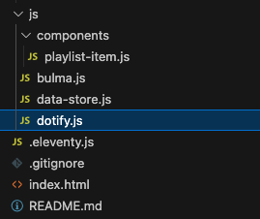
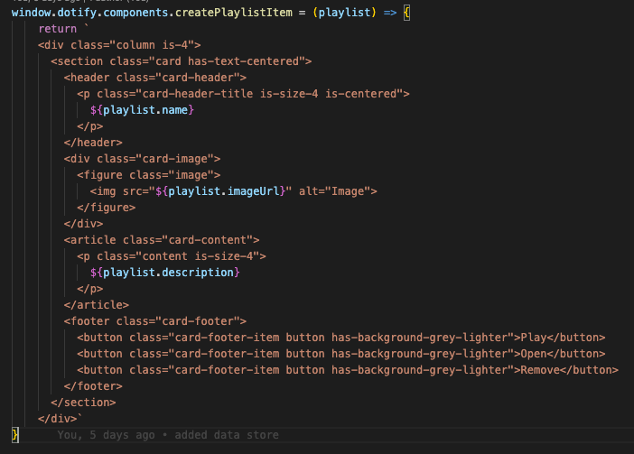
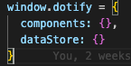
dotify namespace

Slide 26
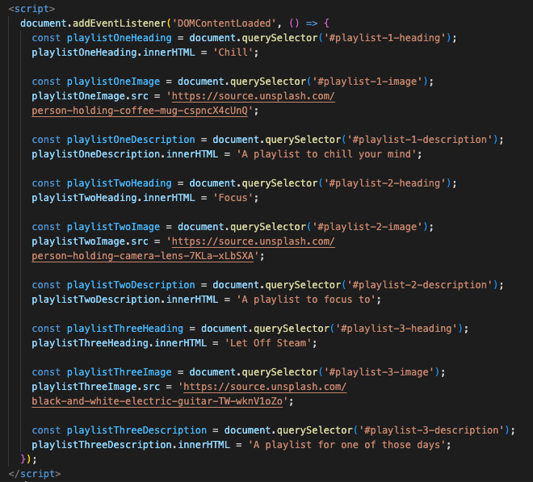
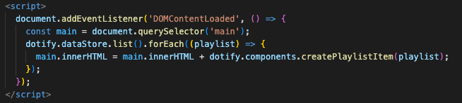
Before vs After
Our UI (view) is now data driven via a data store (model)
We now have a dotify namespace to prevent clashes
We now have the ability to create components

Slide 27
Today
What is a data model?
Building a UI from data
Introducing components
What is model view controller?
Introducing a datastore
Creating a namespace

Slide 28

Do I need to do all this for my assignment?

Slide 29
No

Slide 30
Passing Pathway
Grade Band | JavaScript | Dev Experience | Submission and Deployment | Release | Release Features
starter | Understanding of best practices: let and const Usage of arrays Usage of object | Clearly laid out project structure – HTML, CSS and JavaScript | Zip file to moodle | POC – 1 - City Focus 1 1 City with today’s weather | Weather Code Mapped to Correct Weather Display City Name Clear it is today’s weather Max Temp and Wind
baseline | Add and Remove elements from the DOM without the need for a screen refresh | DRY - Very little Repetition of HTML, JS and Styles | + github repository link + github commit history | POC – 2 – City Focus 2 + current hour’s weather | Added current hours forecast Correctly mapped hourly weather code Correct hour taken from browser
good | Understanding of application name spacing and scopes | Layered JavaScript Architecture - MVC | + github tags | POC – 3 – City Focus 3 + 7 days summary | Clear and concise summary for the 7 days Weather code correctly mapped Additional weather information
excellent | Well maintained utility file(s) Clear and concise loading of javascript Functions utilized correctly | Excellent README | + Manual upload to netlify | Release -1 + Dashboard | Focus on user experience Ability to navigate to city view Ability to navigate back to dashboard Usage of URL paths and parameters
outstanding |  |  | + github push to master deploys to netlify | Release – 2 + Configure and Persist User Preferences | User preferences user interface User preferences saved in localStorage Clear navigation User preferences affect how the dashboard render Reset preferences
amazing |  |  | - | Release – 3 + Build out your own features | Start small and build from there Do not start this without a lot of the previous releases done, don’t feel pressure to get here
Considered more advanced

Slide 31
